Slide 1

Computing Algorithms Lecture 1
By: Dr. Mohamed Moheeb

Slide 2
Agenda
The Course plan
What is an algorithm
Important Problem types
Fundamental Data Structures

Slide 3

Course Plan

Slide 4
Course Content
Introduction to computing Algorithm (week 1)
Fundamentals for algorithm analysis (week 2-3)
Brute Force (week 4-5)
Decrease and Conquer (week 6)
Divide and Conquer (week 8-9)
Transform and Conquer (week 10)
Space and Time Trade-Offs (week 11)
Dynamic Programming (week 13)
Greedy Technique (week 14)

Slide 5
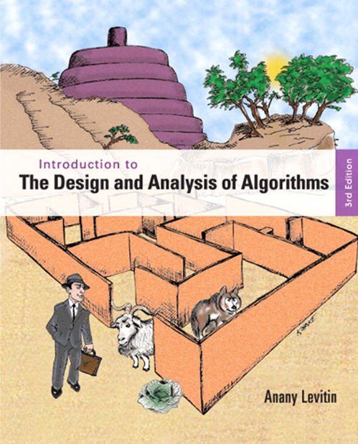
Course Book

Slide 6
Course Grades
Week 5: 5% (quiz)
Week 7: 20% (exam) & 5%(assignment)
Week 10: 5% (quiz)
Week 12: 15% (project)
Prefinal: 10% (assignment)
Final: 40% (exam)
Note: Each student who exceeds 20% in course attendance will receive a warning; at 25%, the course will be withdrawn. Every student should attend according to their schedule, and if you are absent, you are responsible for following up on what you missed.

Slide 7

Fundamentals of algorithms

Slide 8
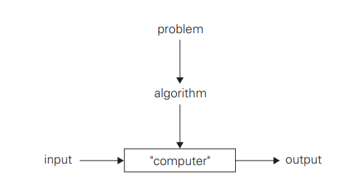
What is an algorithm
An algorithm is a sequence of unambiguous instructions for solving a problem, i.e., for obtaining a required output for any legitimate input in a finite amount of time
Book: Introduction to the Design and Analysis of Algorithms

Slide 9
What makes a good algorithm ?
Let’s take an example of how to find the greatest common divisor (GCD using two different algorithms
The GCD of 60 and 24 is 12, which is the largest number that both input numbers are divisible by.

Slide 10
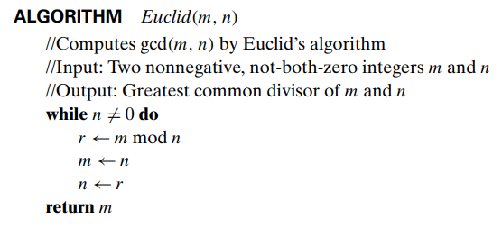
Euclid’s Algorithm
Iteration 1
Given that inputs for the Euclid(m,n) are m=60 and n=24
is not equal to 0, then the Condition for the while loop is true.
Variables
n= 24
m=60

Slide 11
Euclid’s Algorithm
Iteration 1
r= 60 % 24 = 12
Variables
n= 24
m=60
r= 12

Slide 12
Euclid’s Algorithm
Iteration 1
m= n = 24
Variables
n= 24
m=24
r= 12

Slide 13
Euclid’s Algorithm
Iteration 1
n=r= 12
Variables
n= 12
m=24
r= 12

Slide 14
Euclid’s Algorithm
Iteration 2
Since n is still ≠ 0, the condition is true
Variables
n= 12
m=24
r= 12

Slide 15
Euclid’s Algorithm
Iteration 2
r= 24 % 12 = 0
Variables
n= 12
m=24
r= 0

Slide 16
Euclid’s Algorithm
Iteration 2
m= n = 12
Variables
n= 12
m=12
r= 0

Slide 17
Euclid’s Algorithm
Iteration 2
n=r= 0
Variables
n= 0
m=12
r= 0

Slide 18
Euclid’s Algorithm
Since n =0 ,the condition is false
Variables
n= 0
m=12
r= 0

Slide 19
Euclid’s Algorithm
The function returns m=12 which is the GCD.
Variables
n= 0
m=12
r= 0

Slide 20
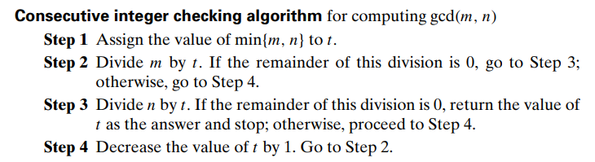
Consecutive integer checking algorithm
The inputs are also m=60 and n =24
t=min{60,24}=24
Variables
n= 24
m=60
t= 24

Slide 21
Consecutive integer checking algorithm
Iteration 1
m/ t =60/24, where the quotient is 2 and the remainder is 12
Since the remainder is not equal to 0, then we go to step 4.
Variables
n= 24
m=60
t= 24

Slide 22
Consecutive integer checking algorithm
Iteration 1
t is equal to t-1 = 24 -1 =23
Go to step 2 again
Variables
n= 24
m=60
t= 23

Slide 23
Consecutive integer checking algorithm
Iteration 2
m/ t =60/23, where the quotient is 2, and the remainder is 14
Since the remainder is not equal to 0, we go to step 4.
Variables
n= 24
m=60
t= 23

Slide 24
Consecutive integer checking algorithm
Iteration 2
t is equal to t-1 = 23 -1 =22
Go to step 2 again
Variables
n= 24
m=60
t= 22

Slide 25
Consecutive integer checking algorithm
Iteration 2
m/ t =60/23, where the quotient is 2 and the remainder is 14
Since the remainder is not equal to 0, we go to step 4.
Variables
n= 24
m=60
t= 23

Slide 26
Consecutive integer checking algorithm
Iteration 2
t is equal to t-1 = 23 -1 =22
Go to step 2 again
Variables
n= 24
m=60
t= 22

Slide 27
Consecutive integer checking algorithm
Iteration 3
m/ t =60/22, where the quotient is 2 and the remainder is 16
Since the remainder is not equal to 0, we go to step 4.
Variables
n= 24
m=60
t= 22

Slide 28
Consecutive integer checking algorithm
Iteration 3
t is equal to t-1 = 22 -1 =21
Go to step 2 again
Variables
n= 24
m=60
t= 21

Slide 29
Consecutive integer checking algorithm
Iteration 4
m/ t =60/21, where the quotient is 2 and the remainder is 18
Since the remainder is not equal to 0, then we go to step 4.
Variables
n= 24
m=60
t= 21

Slide 30
Consecutive integer checking algorithm
Iteration 4
t is equal to t-1 = 21 -1 =20
Go to step 2 again
Variables
n= 24
m=60
t= 20

Slide 31
Consecutive integer checking algorithm
Iteration 5
m/ t =60/20, where the quotient is 3, and the remainder is 0
Since the remainder is equal to 0, we go to step 3.
Variables
n= 24
m=60
t= 20

Slide 32
Consecutive integer checking algorithm
Iteration 5
n/ t =24/20, where the quotient is 1 and the remainder is 4
Since the remainder is not equal to 0, we go to step 4.
Variables
n= 24
m=60
t= 20

Slide 33
Consecutive integer checking algorithm
Iteration 5
t is equal to t-1 = 20 -1 =19
Go to step 2 again
Skipping the remaining iterations till reaching iteration 13
Variables
n= 24
m=60
t= 19

Slide 34
Consecutive integer checking algorithm
Iteration 13
m/ t =60/12, where the quotient is 5, and the remainder is 0
Since the remainder is equal to 0, we go to step 3.
Variables
n= 24
m=60
t= 12

Slide 35
Consecutive integer checking algorithm
Iteration 13
n/ t =24/12, where the quotient is 2 and the remainder is 0
Since the remainder is equal to 0, then we return t=12 and stop.
Variables
n= 24
m=60
t= 12

Slide 36
Which algorithm is better ?
Both get the final answer correctly, but Euclid's algorithm is much faster.
Conclusion:
The strategy or technique used for designing an algorithm affects how good the algorithm is( Euclid’s algorithm uses decrease and conquer, while consecutive integer checking uses brute force)
The input values for the algorithm affect the number of iterations to be executed; a better algorithm can reduce the number of iterations without affecting the output of the algorithm. (time complexity).

Slide 37
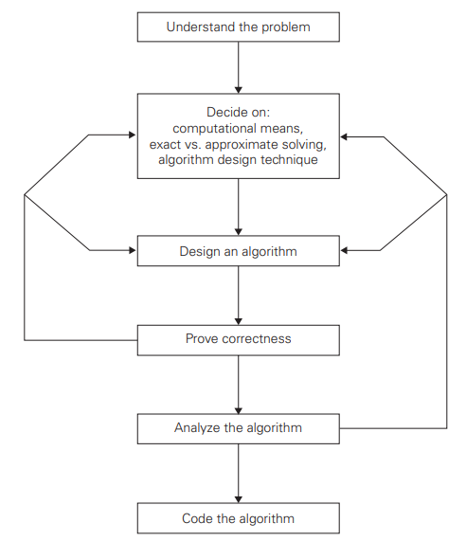
Fundamentals of Algorithmic Problem Solving
Book: Introduction to the Design and Analysis of Algorithms

Slide 38

Important problem types

Slide 39
Sorting
The sorting problem is to rearrange the items of a given list in nondecreasing order
https://github.com/CarolinaDCode/sorting_algorithms

Slide 40
Searching
The searching problem deals with finding a given value, called a search key, in a given set
https://sushrutkuchik.wordpress.com/2020/05/24/searching-algorithms-visualized/

Slide 41
String processing
are essential for manipulating and analyzing text data.
Examples:
String Manipulation, like reversing or concatenating
String matching to find a substring in a string
Longest Common Subsequence (LCS) used in DNA sequences

Slide 42
Graph problems
Graphs can be used for modeling a wide variety of applications, including networks or traffic
https://stemlounge.com/animated-algorithms-for-the-traveling-salesman-problem/

Slide 43
Combinatorial problems
These are problems that ask, explicitly or implicitly, to find a combinatorial object such as a permutation, a combination, or a subset that satisfies certain constraints.
Example: permutation for of A,B,C
A,B,C
A,C,B
B,A,C
B,C,A
C,A,B
C,B,A

Slide 44
Geometric problems
Deal with geometric objects such as points, lines, and polygons
Example:
Closest pair problem
Convex-hull problem
https://www.geeksforgeeks.org/dsa/closest-pair-of-points-using-divide-and-conquer-algorithm/

Slide 45
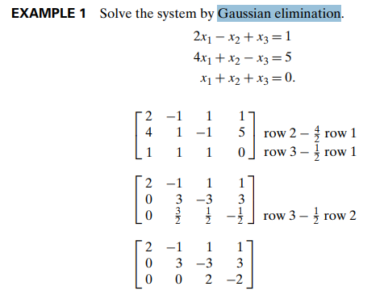
Numerical problems
are problems that involve mathematical objects of continuous nature: solving equations and systems of equations, computing definite integrals.
Book: Introduction to the Design and Analysis of Algorithms

Slide 46

Fundamental Data Structures

Slide 47
Fundamental Data Structure
In essence, the data structure is the foundation of the algorithm.
A well-chosen data structure enables elegant, efficient solutions.
A poor choice can render even the most logically sound algorithm impractical.

Slide 48
Linear Data Structures
Arrays: an index indicates the value and a 1D or 2D array
Linked list: each element is called a node and is connected to the others using a pointer,
Stack: is like a linked list, where the top of the stack is the only visible part, and you either insert to the top (push) or return and delete the top (pop). (LIFO)
Queue: is also similar to the linked list, where the elements are deleted from one end, the front of the queue (dequeue), and new elements are inserted at the end of the queue (enqueue). (FIFO)

Slide 49
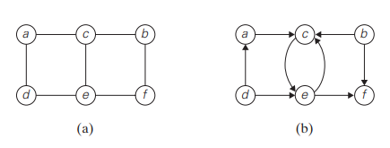
Graphs
Graphs consist of several nodes (vertices) that are connected to each other through a link (edges).
There are two types of graphs:
Undirected graph
Directed graph (digraph)
Book: Introduction to the Design and Analysis of Algorithms

Slide 50
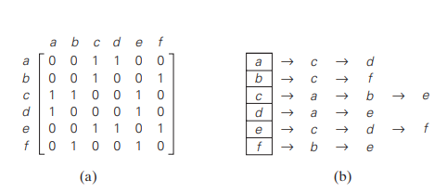
Graph Representations
The graph can be represented using:
Adjacency matrix
Adjacency lists
Book: Introduction to the Design and Analysis of Algorithms

Slide 51
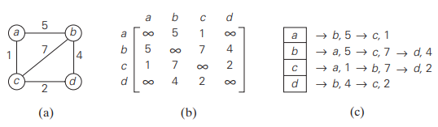
Weighted Graphs
is a graph (or digraph) with numbers assigned to its edges. These numbers are called weights or costs
Book: Introduction to the Design and Analysis of Algorithms

Slide 52
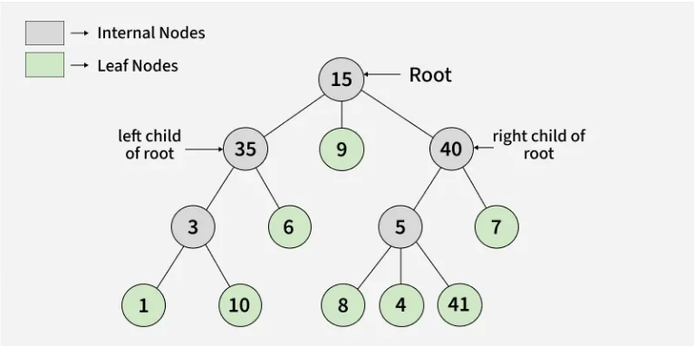
Tree
A rooted tree in which all the children of each vertex are ordered (ordered tree)
The height of a tree is the length of the longest simple path from the root to a leaf
https://www.geeksforgeeks.org/dsa/introduction-to-tree-data-structure/

